Slide 1
Amazon Retail Arbitrage 2023
By Adnan Majeed
Instructor computer learning center

Slide 2
Have you been wanting to sell on Amazon but don’t know how to get started or don’t yet have the budget to launch a private label product? One great method to get started is through retail arbitrage. You can start with as little or as much money as you’re comfortable with — you can even do it without stepping foot inside a store!

Slide 3
What is retail arbitrage?
Arbitrage is the practice of taking advantage of a price difference between two or more markets, or, in other words, reselling.
In this case, retail arbitrage is the process of buying discounted products through retailers (including online retailers) to sell on Amazon.
An example of this would be finding a product at Walmart that sells for $5, purchasing that product, and then reselling it on Amazon for $20. Pretty cool, right?
Some sellers also buy products they find online, which is known as online arbitrage, and the process is the same: buy low, sell high (on Amazon).
You may be asking yourself, “is retail arbitrage legal?” Fortunately, it is. According to the first-sale doctrine, once you purchase a product legally, you then have the right to resell that product, as long as it is sold in an unchanged condition. So if you buy and sell it as new, the product must be sold in new condition.

Slide 4
How does retail arbitrage compare to other business models on Amazon?
Private label is when you create your own product label/brand, generally by modifying an existing product in the market. For example, you can create a higher quality garlic press than one already selling on Amazon, reproduce it from a manufacturer, and add your logo to it. It’s the most common method of selling on Amazon and can be incredibly profitable, but most sellers need some capital to get started.
Wholesale is when you buy products in bulk directly from a brand or from distributors with extra stock to sell on Amazon, which also requires start-up money. This does not involve ordering products from retail stores. Wholesale is a more sustainable business model as you can replace orders every month and you are an authorized reseller, meaning you don’t have to worry so much about inauthentic claims.
Dropshipping is when you buy products directly from a manufacturer who fulfills the order and ships directly to the customer.
Handmade is the process by which you create or craft your own products to sell on Amazon.

Slide 5
Why would you choose arbitrage over other models of selling on Amazon?
Lower cost to start: According to Jungle Scout’s study of more than 1,000 Amazon sellers, 12% of those doing arbitrage were able to launch Amazon businesses with less than $500, and about 32% did so for less than $1,000. By contrast, 80% of private label sellers spent $1,000 or more to launch.
Faster to start: Two in five (33%) retail arbitrate sellers said they were able to launch Amazon businesses in less than one month. Only a 14% of private label sellers said the same.

Slide 6
38% of retail arbitrage sellers also run a wholesale business
24% also sell private label
17% also have a dropshipping business
11% also sell handmade products

Slide 7
How to get started with retail arbitrage
In order to start selling retail arbitrage on Amazon, you need to find products to sell and you need to create an Amazon seller account. Ultimately, you’ll also want to decide whether to fulfill your products yourself (Amazon’s Fulfillment by Merchant or FBM program) or have Amazon handle the packing, shipping, and customer service (Fulfillment by Amazon or FBA). Hint: you can do both! See more on FBA vs. FBM here.
While different tools and software are available that will help you find products to resell, the only thing you really need is the Amazon seller app, which is free to use with your Amazon seller account.

Slide 8
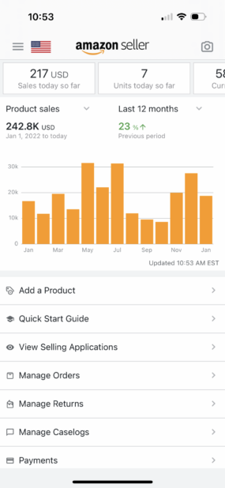

Slide 9
The Amazon seller app allows
Monitor your sales
Answer customer messages
Manage orders and returns
Scan product barcodes
Check a product’s profitability
List products on Amazon
And much more
Another tool that makes finding profitable products easier and is useful for both retail and online arbitrage is Jungle Scout’s Extension.

Slide 10
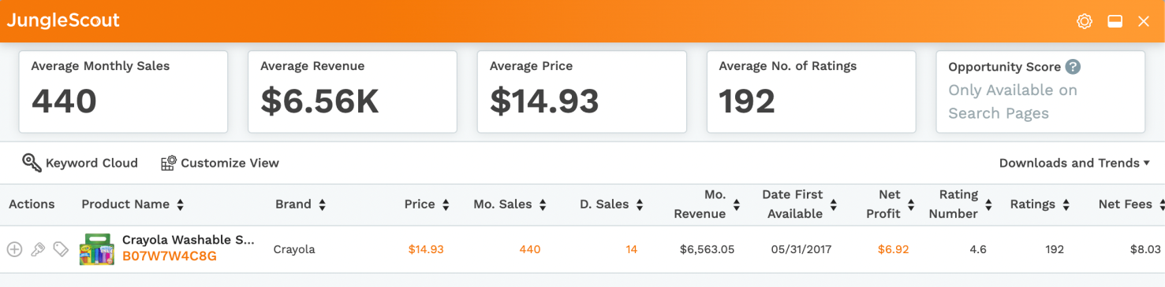
Jungle Scout Extension
Jungle Scout Extension allows you to get a quick snapshot of how well a certain product sells on Amazon at the click of a button. You simply enable the Chrome extension as you’re browsing a listing on Amazon, and you can view price history, sales history, as well as a product’s profitability.

Slide 11
How to source retail arbitrage products to resell on Amazon
Stores to source products to resell on Amazon:
Walmart
Target
Kohl’s
Marshalls
Ross
TJ Maxx
Homegoods
Dick’s Sporting Goods
Dollar General or other dollar stores
CVS/Walgreens/Rite Aid or other convenience stores
Burlington
Grocery stores

Slide 12
Types of products to resell on Amazon:
he 10 most popular Amazon product categories that arbitrage sellers sell in include:
Home & Kitchen: 2547% of arbitrage sellers sell here
Cell Phone & Accessories: 18%
Electronics: 18%
Arts, Crafts & Sewing: 16%
Grocery & Gourmet Food: 16%
Toys & Games: 14%
Appliances: 12%
Beauty & Personal Care: 11%
Books: 11%
Sports & Outdoors: 9%

Slide 13
Step 1: Go into a retail store and start scanning products
It may be intimidating and awkward to just walk into a retail store and begin scanning items with your phone, but remember that everyone starts somewhere!
Using the Amazon seller app, hit the camera button in the top right corner.
This will look just like you are using your camera on your phone. You can use the camera in the app to scan the product packaging and search by image or to scan a barcode.

Slide 14
Step 2: Go through the search results and choose the correct listing
It is not uncommon when scanning products using the Amazon seller app to see multiple results. You’ll notice that many products have either duplicate listings or some listings will be a 2-pack, 3-pack, etc.

Slide 15
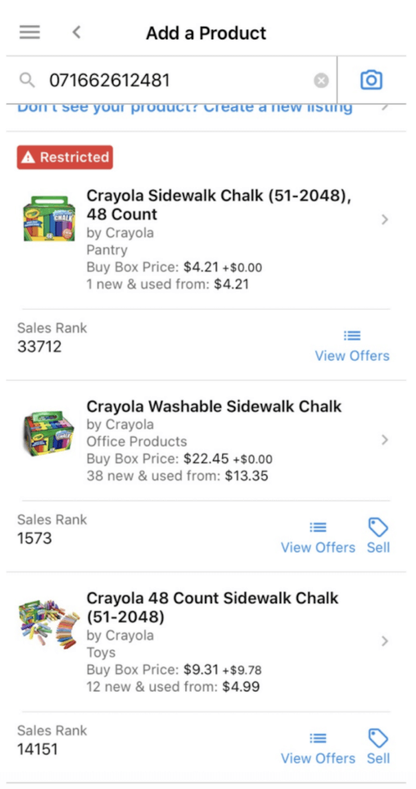

Slide 16
On the first result, you can see right away that it is restricted. If you click on that first option, the next screen will read “You cannot sell this product in new condition.” So now I know to stay away from that listing.
In the second option, I can see the current Buy Box price is $22.45, so I am going to click on that listing.

Slide 17
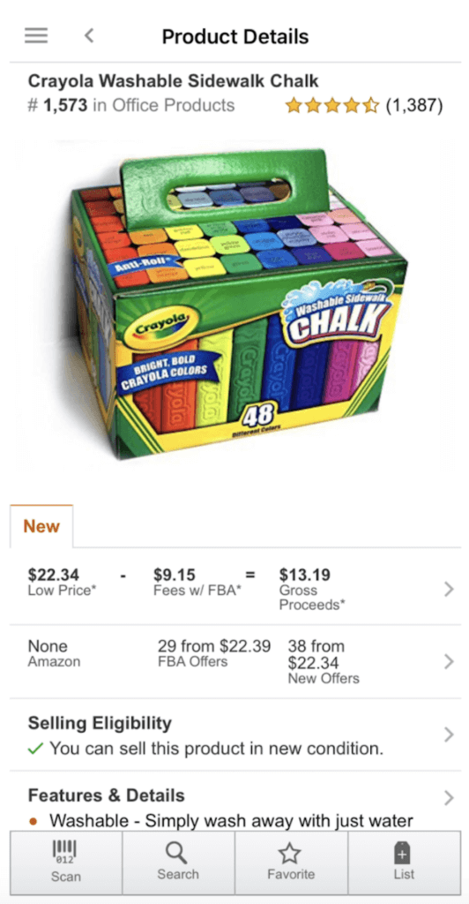
Step 3: Analyze the data

Slide 18
Features & Details
:After looking at the details, we know this listing is for one box of 48 pieces of chalk.
Sales Rank: You can see this right under the title as well as in the Features & Details section. The Best Sellers Rank is different for each category on Amazon but a general rule of thumb is to look for products under 100,000 sales rank. The lower the number, the more it sells. So for our example, a sales rank of 1,573 is very good for Office Products. Keep in mind that this number can be misleading as it may indicate a random burst of sales that day. This is why it’s important to use a tool like the Jungle Scout Extension to see if that rank is consistent. You can also check the estimated number of monthly sales based on sales rank for free using the Jungle Scout Sales Estimator.

Slide 19
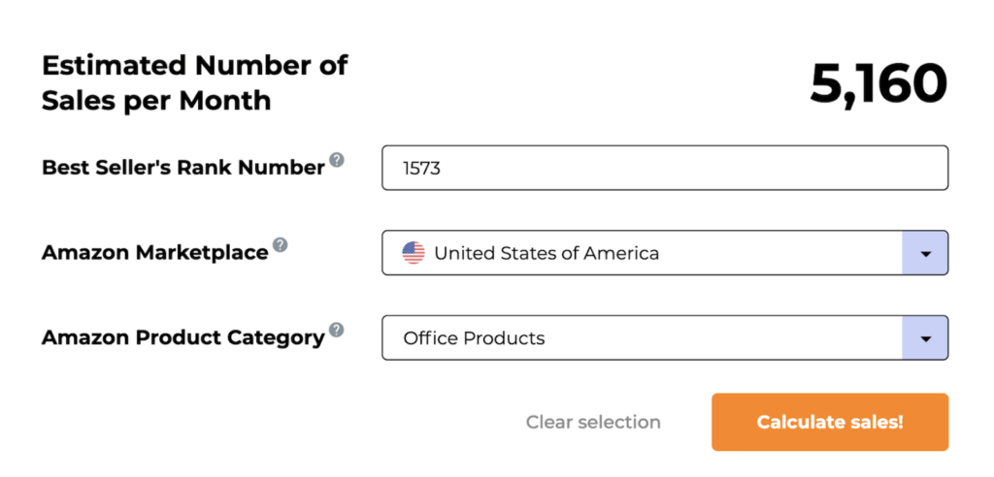

Slide 20
Sellers on the listing: In the second row under “New,” you will see if Amazon is on the listing, the number of FBA sellers, and the total number of sellers, including FBM. I try to avoid all listings that Amazon is on because it doesn’t always share the Buy Box with third-party sellers, which may get you stuck with inventory you cannot sell.
There are a lot of FBA sellers on this listing, but with such a low sales rank, this product would still be a good buy as long as it is profitable.
Price and Gross Proceeds: The most important piece of the puzzle: can you now sell the product at a profitable price? If you click on the pricing section, you will be able to input your buy cost and Amazon will break down all of the fees so you can decide whether or not you should buy this product.
In the app, input your buy cost and it will automatically show you the potential profit.
For this particular product, I am able to purchase it for $5.74. Based on the current selling price minus FBA fees and buy cost, my profit would be $7.45. That is over a 100% ROI, so I would buy this product!

Slide 21
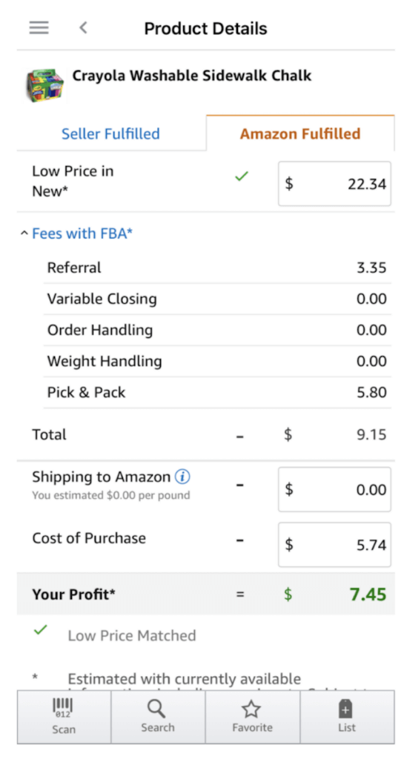

Slide 22
What’s the difference between Amazon FBA and FBM?
Fulfillment by Amazon (FBA): A method of selling on Amazon in which a seller (or a seller’s supplier) sends their products directly to Amazon’s warehouses. Amazon then stores the inventory and ships it directly to the customer (often through their 2-day Prime shipping). They also manage customer support.
Fulfillment by Merchant (FBM): A method of selling on Amazon in which a seller lists their products on Amazon, but manages all storage, shipping, and customer support themselves (or through another third-party).

Slide 23
Step 4: Decide how many units to buy
Your decision about how many units of a product to buy (if there are a lot of them available) is based on your own personal risk tolerance. For the example used above, there were 22 FBA sellers with an estimated 5,000 monthly sales based on the sales rank. To figure out how many units you can potentially sell in a month, divide the number of monthly sales by the number of FBA sellers.
5,000/22 = 227
This means you could potentially sell more than 200 units of this product per month. Of course, this can vary depending on if new sellers hop onto the listing, if the sales rank drops, or if the Buy Box price decreases.
If you are new to retail arbitrage or selling on Amazon in general, I suggest starting with a small amount of units to validate the product. For the above sidewalk chalk example, consider starting with 5 or 10 units and see how it sells.

Slide 24
Step 5: Determine your target ROI/profit margin
What is ROI?
Your return on investment, or ROI, is the amount of money you make back that (ideally) exceeds the amount you put into your business venture.
For example, if you purchase a product for $10 and your gross proceeds after a sale were $12, your ROI is the difference (profit: $2) divided by your investment, or 20%.
Obviously, you want to aim for the highest ROI possible, not only so you make more money per sale, but so there is some wiggle room in case the Buy Box price decreases.
The minimum ROI you accept will vary depending on your own preferences. Some sellers are comfortable with making a small ROI (this is subjective, but say 20%) as long as they sell the product within a month, while other sellers want to make at least 50% ROI for it to be worth it

Slide 25
Online arbitrage
Online arbitrage works essentially the same way retail arbitrage does, except you’ll search for products on retailer websites instead of in-store aisles. The best part about online arbitrage is that you can do it without leaving your house!
There are a few paid software and tools out there that can help you automatically scan through thousands of products but you can still find profitable products going through ecommerce stores manually.
Similar to a retail store, online retailers will have sale and clearance pages with a number of discounted products. This is a good place to start because there’s a good chance the price will be higher on Amazon. This effort can be time-consuming, but worth it if you are consistent and put in some effort.
Manually go through each clearance or sale item and search for that same product on Amazon. If the price is higher on Amazon, use Jungle Scout’s Extension to get an estimate on how many times that product sells per month. You can also use Extension to determine the potential profit, show you historical price and sales data, and whether Amazon itself has ever sold that product.

Slide 26
Arbitrage tips:
Follow trends and sell seasonal products
While you could go into a store or look around online for products that might be profitable to resell on Amazon, you could also do some research and think ahead for certain types of products you’d like to find.
One thing to consider is seasonality. Try to figure out what products are currently or soon-to-be trending or products that sell more during a certain time of year.
For example, toys during the holiday season or inflatable pools or floats during the summer are extremely popular (and profitable). Since the demand is so high during those times, supply tends to diminish very quickly in retail stores, which translates into an increased selling price online.
During the summer of 2020, you could purchase an inflatable pool at Walmart for $20 and resell it on Amazon for $80. And yes, customers will purchase a product at that much-higher price point if they cannot find it in-store and really want the item.
If you stay on top of trends and current events like these, you will be on your way to having a profitable Amazon reselling business.

Slide 27
Sell discontinued products for massive profits
Has there ever been a product that you absolutely loved but then for whatever reason, the brand decided to discontinue it? We’ve all been there, and we know we’d pay a premium to get those products back. Some consumers are willing to pay extraordinary amounts of money for products that are seemingly impossible to find.
You may be thinking, if a product is discontinued, then how can I still find it in-store? Some discontinued products are still circulating in the market and will randomly pop up in retail stores, discount stores, grocery stores, etc. It is just up to you to be in the right place at the right time.

Slide 28
Tips on finding discounted products:
Shop in local stores, not a big box retailer such as Walmart. A “mom-and-pop” shop is more likely to carry these random, discontinued items.
Looks for items that just look old. I know that sounds odd, but you may spot some products with labels that look outdated, faded, or even dusty.
Look for items labeled “refills.” There are lots of products in the cleaning category that require refill packs to continue using the product. For whatever reason, lots of the refills become discontinued, but people still really love using them.
Go on eBay and search for “discontinued.” Then filter by sold listings only. This will show you all of the products labeled “discontinued” that have recently sold on eBay.

Slide 29
SC Johnson One Step No Buff Wax Fine Wood Floor Care 22 Fl Oz
Find it at hardware stores, mom-and-pop grocery stores, and garage sales.
Off! Repellent Mosquito Lamp Refills
Find it at hardware stores, grocery stores, discount stores, and liquidation stores.
McCormick Total Seasoning for Chicken and Fish
Find it at large and mom-and-pop grocery stores.

Slide 30
Some additional tips and strategies when doing arbitrage:
Be patient. Going into retail stores and scanning item after item can become very exhausting. It also becomes frustrating when you aren’t finding any profitable products. Just keep going! Eventually, you will find products that will make you money on Amazon.
Base your buying decisions on data you see in the Amazon seller app and the Jungle Scout Extension. You don’t want to buy something that you won’t be able to sell.
Prices can change in an instant if another seller “tanks the price.” Meaning the product you purchase may not be profitable anymore. This is why you need to check price history as well.
Start small to get used to the process. Before going all-in and spending tons of money on products to resell on Amazon, start with a small quantity so you can get a better understanding of sourcing, listing, shipping, pricing, and more.

Slide 31
How to list your arbitrage products on Amazon
The next step in reselling products on Amazon is how to actually list your product for sale. Since this is not a private label product, you will not be creating a brand new listing. You are simply going to find the current listing you want to sell on and add that ASIN to your catalog in Seller Central.
This means that, unlike private label where you will be the only seller of your product, you will end up sharing the buy box with multiple sellers. If you find a product that sells roughly 300x a month, know that you will not receive all 300 of those sales if there are other sellers on the listing.
There are a couple of ways you can do this, so let’s walk through each one.

Slide 32
Option 1: List the product from the Amazon seller app
After you scan a product in the seller app, you have the option to list the product as Fulfilled by Merchant (FBM) or Fulfilled by Amazon (FBA). If listing as FBM, you can choose to add in your available inventory in the app so your offer will immediately be available for sale.

Slide 33
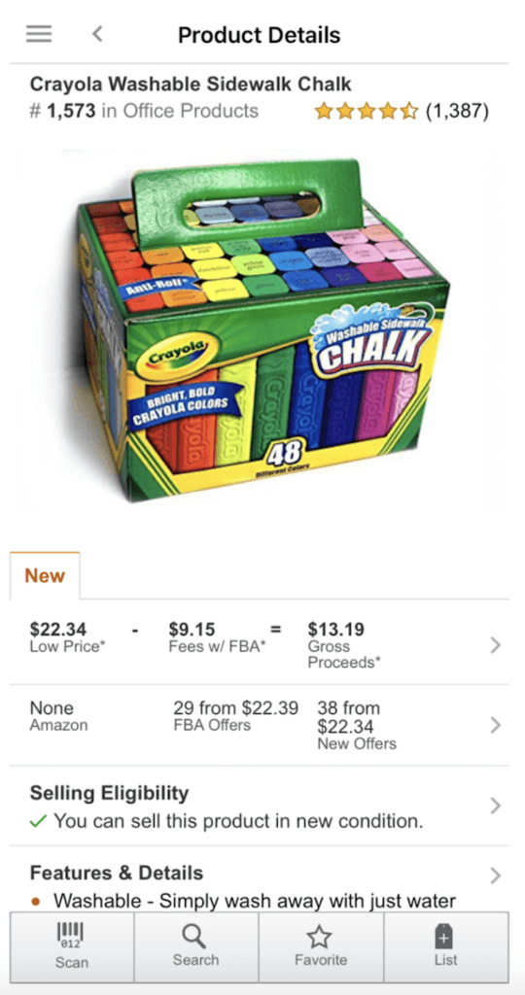

Slide 34
In the bottom right-hand corner, click “List.” You will see condition, price, SKU, and fulfillment channel.
For condition choose “New.”
The pricing section can get tricky so please pay attention to this part. Amazon will have the option to “Match Low Price.” This may sound like what you want to do but do not choose this option without checking the FBA prices first.

Slide 35
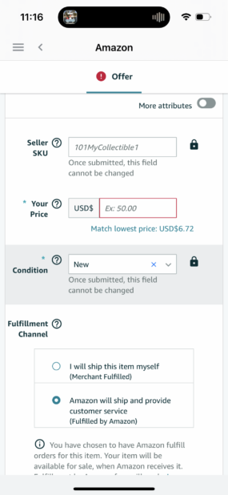

Slide 36
Amazon is showing me the lowest price for New is $6.72. If we choose this price, the product would not be profitable.
However, that is the lowest price for an FBM offer, not an FBA offer. If you look back at the pricing section, you will see the lowest FBA price is $22.39. That is the lowest price you want to list at. If you go lower, you will be the seller that tanks the price and ruins the profitability.
I usually set my price a couple of dollars higher than the current Buy Box price. You can always adjust when your inventory arrives at an FBA warehouse and is ready to sell.

Slide 37
Option 2: List in seller central on your desktop/laptop
This is the easier way to list your retail arbitrage products on Amazon.
First, I will find the exact listing I want to sell on. Once you do that, copy the ASIN and paste it into Seller Central.

Slide 38
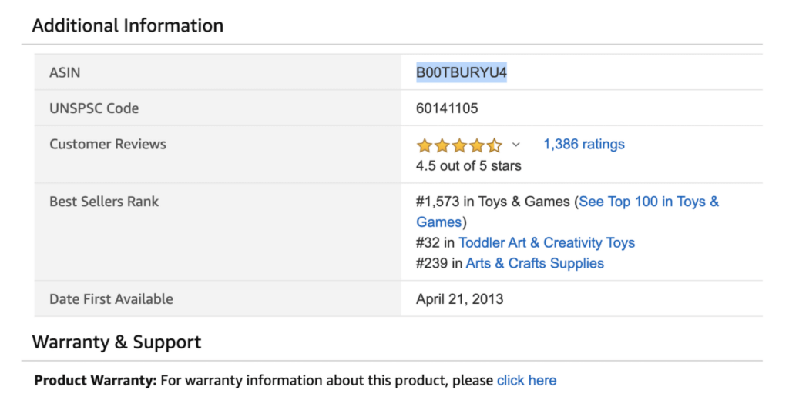

Slide 39
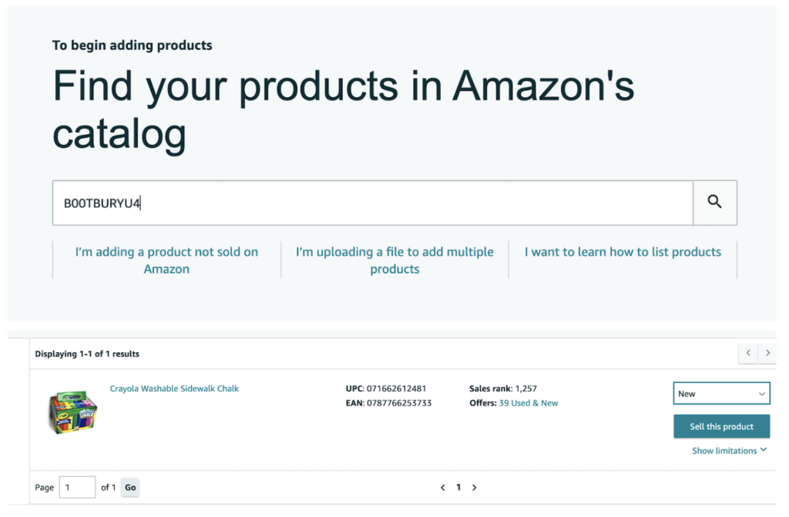

Slide 40
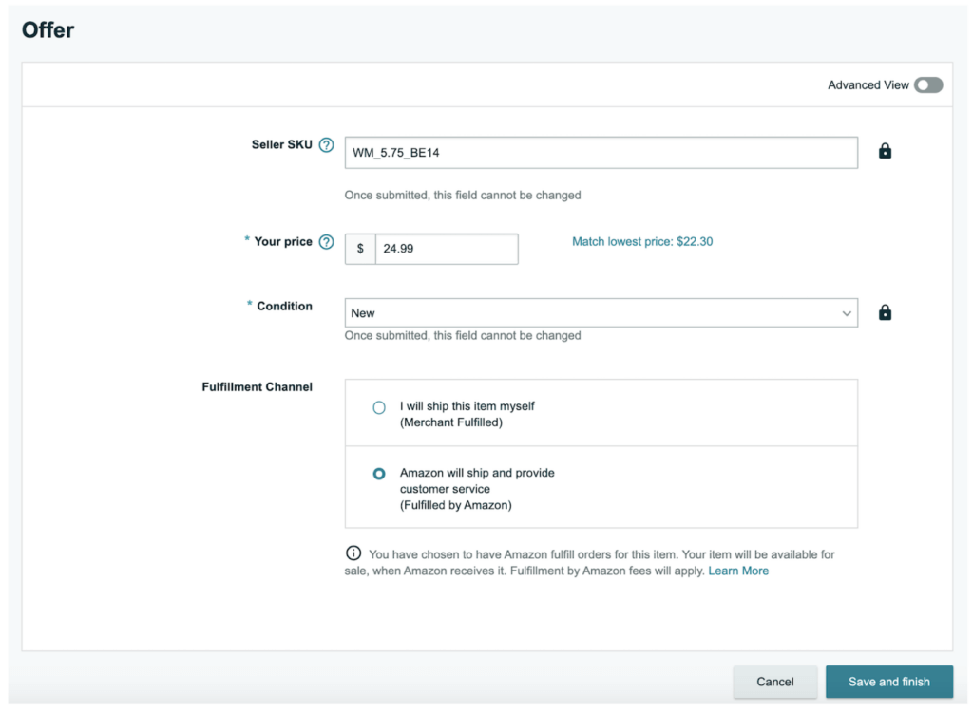

Slide 41
How to create your FBA shipment
Now that you purchased inventory and added the listing within seller central, it is time to send in your inventory! You are one step closer to reselling products on Amazon.
Step 1: Find your product in Manage Inventory
On the far right, you will see “Edit” and a drop-down menu. Click the drop-down arrow and choose “Send/Replenish Inventory.”

Slide 42
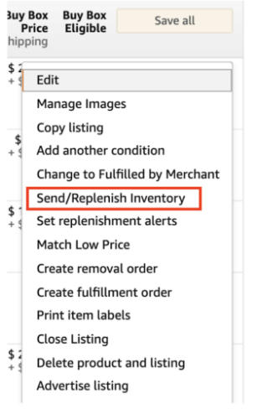

Slide 43
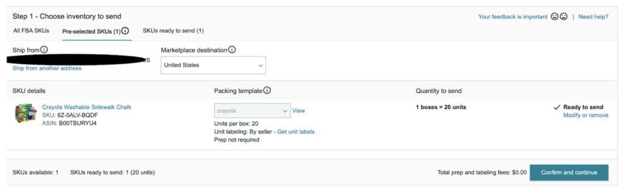
Step 2: Choose inventory to send

Slide 44
Step 3: Confirm shipping
in this section you will set your ship date, shipping mode (between “small parcel” or “less than truckload” you will choose small parcel), and then confirm the inbound shipping price. Since you added in the weight and dimensions in the previous section, there is not much else to do here.
When using Amazon’s partnered carrier (UPS), you will receive extremely low shipping rates. For this example, my 15 pound shipment will only cost $8.69 to ship into FBA.

Slide 45
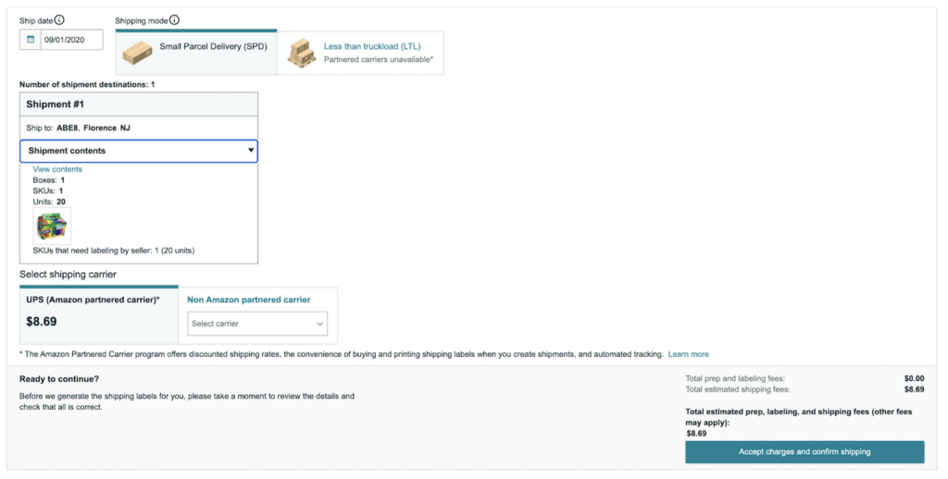

Slide 46
Step 4: Print FBA labels
Now that your shipment is confirmed, all you need to do is print your FBA label and affix it to your box. You will see two barcodes on the label. Make sure both of the labels are visible on the outside of your box. The first is the UPS label and the second is how Amazon will identify who the shipment is from and what is in your box.
You can find our in-depth guide to creating FBA shipments here.

Slide 47
Monitor sales and repeat!
Using the Amazon seller app, you will be able to monitor your daily sales, manage orders, as well as adjust pricing if needed. If you see your products are beginning to sell really well, work on finding more inventory so you can continue making sales.
If your products are not selling as well as you thought, make some pricing adjustments to drive more sales. Remember, format your SKU so you always know what you paid for it!
The key to success in a reselling business is to constantly be hustling and looking for new products. If you enjoy the hustle and going from store to store, then retail arbitrage may be the right business model for you.
Get out there and find some products!
If you have more questions related to retail arbitrage, let us know in the comments!
Interested in the Extension for your retail arbitrage research? Click the link below to learn more about Jungle Scout.

Slide 48
Thanks

